Slide 1
CPAC Services
www.cpacinc.org
860-739-3089 (New London) 203-588-9274 (Stamford)

Slide 2
Connecticut Parent Advocacy Center
Connecticut’s federally funded Parent Training and Information (PTI) Center.
CPAC is a statewide non-profit organization that offers information and support regarding special education law to families of children with disabilities.
Our mission is to educate, support and empower families of children and youth with any disability or chronic conditions, ages birth to 26, and the professionals who serve them.

Slide 3
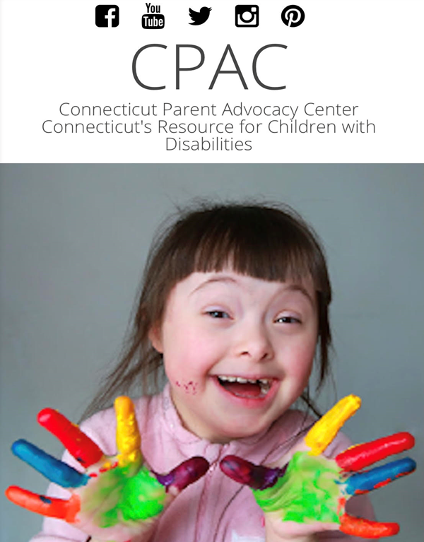
Connecticut Parent Advocacy Center
Adriana Fontaine, Bilingual Parent Consultant and Early Childhood Support Programs Manager afontaine@cpacinc.org
aRPy ambassador to CT

Slide 4
Connecticut Parent Advocacy Center
Our Services:
Over the phone consultation – individual situations
Family Connections Program
In person training – parent and professional
Multilingual Spanish, Portuguese, French and Creole staff (also interpretation line)
Comprehensive Web Site
Work with school districts
Work with State Dept. of Ed and BRS
Early Childhood Programs

Slide 5
Individualized
Parent Training and Information (PTI) Center
  CPAC has a call center for parents and professionals
Effective Conversations
  CPAC facilitates effective communication between families and schools in challenging situations
  Lower-level dispute resolution option
Preschool Pathfinders
  Provides families a higher level of support and coaching as they learn to navigate the special education process in preschool
Notes:
CPAC supports families, districts and community members in many ways, and generally fall under individualized or districtwide supports or programs. Explain PTI and why they should call us, offer materials to distribute. Describe effective conversations, noting this is not advocacy, but coaching and facilitating effective communication; Preschool Pathfinders description

Slide 6
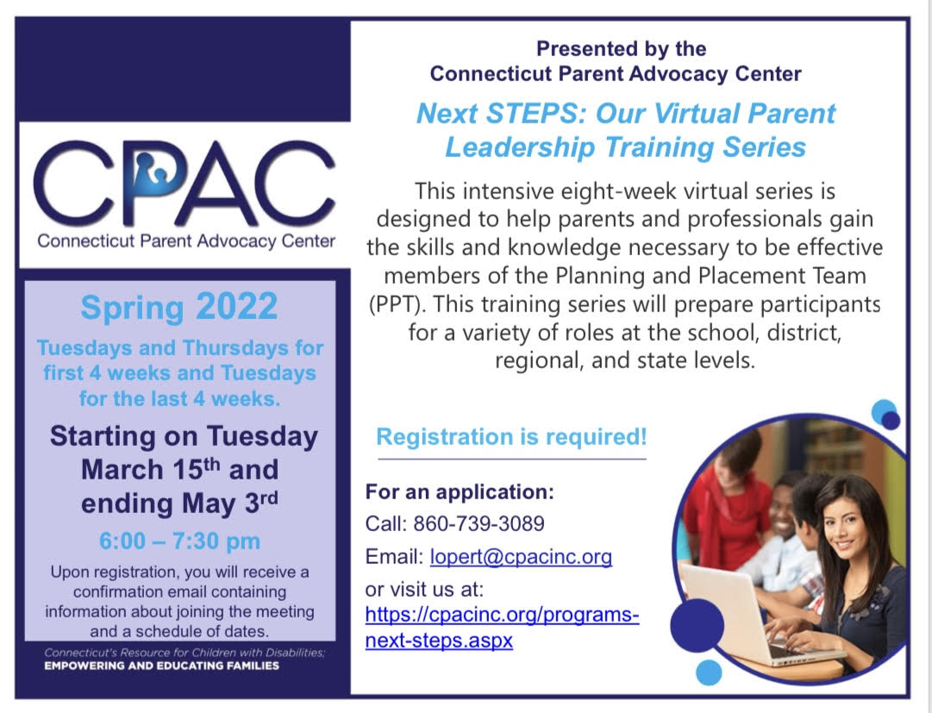
Next STEPS Training
The Parent's Role at the Table: Planning and Progress Monitoring
Developing an Appropriate IEP
Laying the Foundation: Educational Laws and their Impact on Students with Disabilities
Reaching Agreement by Working Together
Transition to Adult Life and Self-Advocacy
Supporting Other Families
Effective Communication Strategies
Notes:
This eight-session intensive series is designed to help parents and professionals gain the skills and knowledge necessary for them to be effective members at the Planning and Placement Team meeting (PPT). This training series will prepare participants for a variety roles at the school, district, regional or state level. Participants will learn about the law related to education as well as state and federal level initiatives that impact students with disabilities and their education. This training is an opportunity to learn how and where to give a voice to the needs of families of students with disabilities. Our goal is for participants to become active and collaborative team members in an effort to support student success. ONLINE, Spring 2022
The training will be held Tuesday and Thursday evenings beginning March 15th, through May 3rd, 2022. Each session begins promptly at 6:00 pm.

Slide 7

Family Connections Program
Family Connections Program (0-3).
Tier I Universal Support-Interactive approach.
Tier II Sustained Supports-One-to one phone consultation.
Tier III Targeted Supports-Mentor support and phone TA, B23 transition conference.

Slide 8
Family Connections Services
Parents and caregivers can request a short-term parent mentor who has “been there” and can help prepare for future planning.
Join a closed Facebook support group for Birth to Three families:
Facebook Support Group
Receive our bi-monthly newsletter.
Access to our First STEPs Parent Training.
Receive one to one phone consultation with one of our Parent Consultants.
Access to Learning Series with Early Childhood Professionals.
Access to a video library of previous trainings (YouTube):
CPAC YouTube Channel

Slide 9
Family Connections a Mom's Story

Slide 10
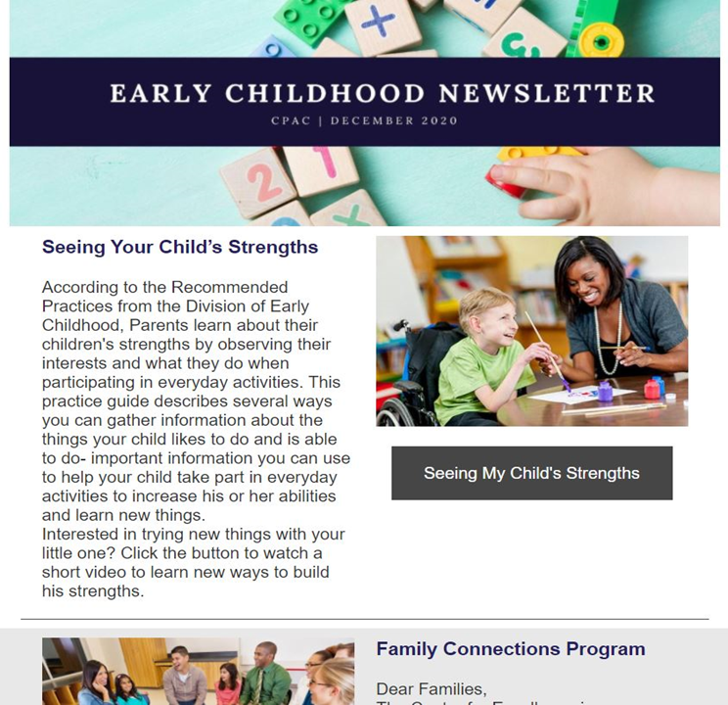
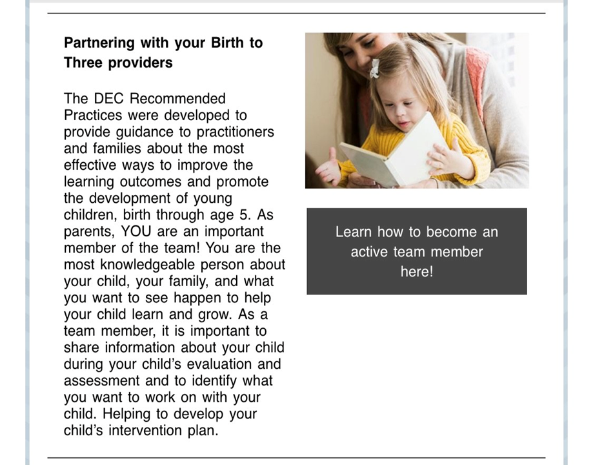
Early Childhood Newsletter (CPAC)

Slide 11
First STEPs Training
This four session intensive series is designed to help parents and caregivers understand Birth to Three System, evaluation process, transition from Birth to Three into Preschool Special Education, advocacy skills and resources available in Connecticut.
This training series will prepare families to understand their role in Birth to Three, understand data derived from evaluations, and how to prepare for when Birth to Three services end.
Our goal is for participants to engage in collaborative practices with their Early Intervention providers, to develop effective advocacy skills, connect with one another and learn how to get the most out of their Birth to Three experience.

Slide 12
First STEPs Training
This learning series covers Early Intervention and Special Education related topics such as:
Getting to know all about Birth to Three and Each Other
Understanding the Individualized Family Service Plan (IFSP): Data Based Decision Making, Evaluations, Child and Family Outcomes
Transition to Preschool Special Education
Describing Your Child’s Unique needs, Advocacy Skills and Resources

Slide 13
How to Make a Referral
CPAC’s website:
Online Match Request Form
Birth to Three Website:
Family Connections Application English
Family Connections Application Spanish
Early Childhood Supports Program Handout:
Early Childhood Support Programs
Parent Mentor Application:
FAQ's Parent Mentor and Application

Slide 14
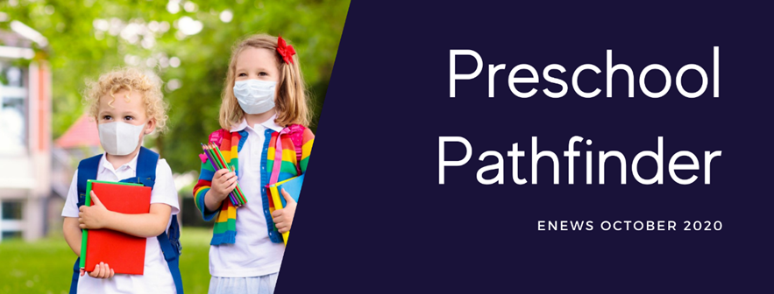
Preschool Pathfinder Program
Developed with the assistance of the CT Department of Education.
Provide direct support to families facing challenges navigating the transition process from Birth to Three to public school or entering special education Pre-K.

Slide 15
Program Goals
Increase knowledge regarding transition procedures.
Increase their knowledge of applicable IDEA main concepts as they relate to transition and the provision of FAPE (Free Appropriate Public Education).
Increase knowledge of the main differences between Birth to Three and Special Education.
Parents will adopt a collaborative disposition to work with school district personnel, B23 providers in the provision of services for their child.
Parents will be able to locate and understand information from evaluation reports, Child’s records, and IEP and they will learn to keep and organize their child’s records.

Slide 16
Preschool Pathfinders
Pre-K Pathfinders are experienced CPAC consultants, who are parents of children with disabilities and have firsthand knowledge of transition procedures, bilingual support (Spanish) is also available.
They review records with the family.
Conduct a needs assessment and create a plan of action.
Attend initial PPT and eligibility PPT.
Assist families to develop effective practices to communicate with public school personnel.

Slide 17
For More Information
CT Parent Advocacy Center
  338 Main Street, Niantic, CT 06357
  (860) 739-3089 Office
  https://cpacinc.org/programs-family-connections.aspx

